Slide 1
Respiratory Acidosis in COPD
Heide Thorne RN BSN
March, 2012
MSN 621

Slide 2
Mr. G presents to the emergency room:
Mr. G is a 64 year old, barrel-chested man who smokes 1 pack of cigarettes a day. He is short of breath and tachypneic with a productive cough. He is using home oxygen at 2 liters per nasal cannula. He recently ran out of his bronchodilators. He has a history of COPD. His O2 saturations are 88% on room air.

Slide 3
The learner will know:
Causes of COPD.
What compensatory mechanisms look like in Chronic COPD.
Why oxygenating the CO2 retainer is done cautiously.
Preventative measures to advise the patient with COPD.

Slide 4
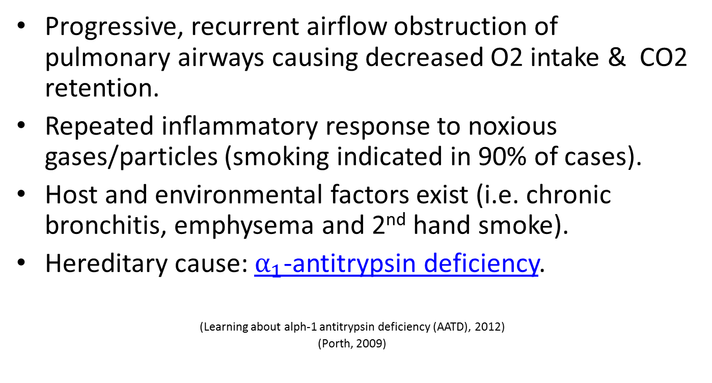
Causes:
Progressive, recurrent airflow obstruction of pulmonary airways causing decreased O2 intake & CO2 retention.
Repeated inflammatory response to noxious gases/particles (smoking indicated in 90% of cases).
Host and environmental factors exist (i.e. chronic bronchitis, emphysema and 2nd hand smoke).
Hereditary cause: $α_{1}$-antitrypsin deficiency.
(Learning about alph-1 antitrypsin deficiency (AATD), 2012)
(Porth, 2009)

Slide 5




This flow chart illustrates how the disease process of Emphysema
relates to smoking and $α_{1}$-antitrypsin deficiency. $α_{1}$-antitrypsin
is a protein that protects the lungs. (Porth & Matfin, 2007)
Attraction of inflammatory cells
smoking
Release of elastase
Action inhibited by $α_{1}$-antitrypsin
Decreased $α_{1}$-antitrypsin activity
Inherited $α_{1}$-antitrypsin deficiency
Destruction of elastic Fibers in lung
EMPHYSEMA

Slide 6
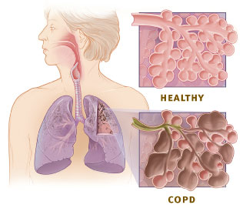
A Die Hard Habit
Smoking is the leading cause of COPD.
Exposure to nicotine causes
inflammation & decreased elasticity
of lungs.
PaCO2 depends on CO2 production & alveolar ventilation. Smoking causes a decrease in alveolar function which leads to hypercapnia. O2 intake is decreased and CO2 is unable to be exhaled.
Mechanical inefficiency of the respiratory system is due in part to decreased elasticity of lungs and demands accessory muscle use and hyperinflation of lungs; another factor in hypercapnia (this is the cause of a barrel chest).
(Quinn & Sinert)

Slide 7
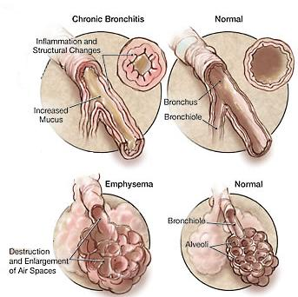
http://www.pharmacy-and-drugs.com/illnessessimages/copd.jpg

Slide 8
A “2 for 1“ Disease
Name two types of obstructive airway disease that when chronic, play a role in COPD?
(Porth & Matfin, 2009)
Chronic Bronchitis
That’s correct! Increased mucous production & chronic productive cough means obstruction of small airways.
Emphysema
Bingo! This leads to enlargement of airspaces & destruction of lung tissue.
Pneumonia
Let’s think this through. Pneumonia can be a complication of COPD but does not contribute to the actual cause.

Slide 9
Which way did he go?
ABG’s are drawn on Mr. G. pH=7.28
PaCO2=60
What respiratory state is he in and which lab value dictates your decision?
Acidosis; dictated by pH & CO2
Yes! Respiratory Acidosis exists when the pH is <7.35 & CO2 is >50. Both values matter when diagnosing Respiratory Acidosis.
Acidosis; dictated by pH only
Partly correct. Acidosis exists when pH is <7.35. CO2 values differentiate between Respiratory & Metabolic acidosis . You will need to know this to treat Mr. G correctly.
Alkalosis; dictated by CO2 only
Let’s rethink this. Alkalosis exists when the pH is >7.45. CO2 levels can be altered in Respiratory & Metabolic states so it won’t help you by itself.

Slide 10
Treatment
An inflammatory response to bacterial & chemical toxins can exacerbate COPD. Consider why these medications might be used to decrease the inflammatory response in the lungs? Click on each box to check your knowledge.
Bronchodilators
These will relax smooth muscle in the lungs & improve lung emptying. Ie. Albuterol & Atrovent
Antibiotics
Antibiotics may be helpful when a bacterial infection is suspected.
Glucocorticoids
Advair & Pulmacort are common inhaled steroids used to regulate the inflammatory response in the lungs.

Slide 11
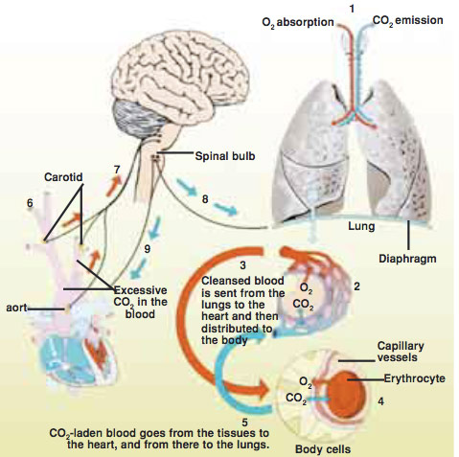
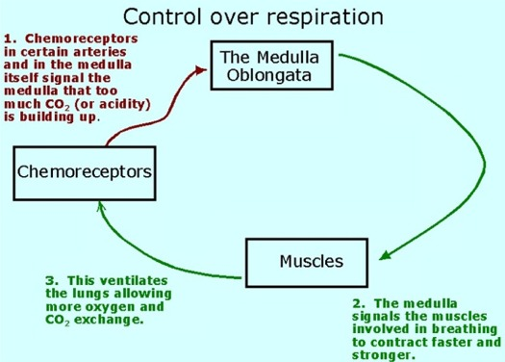
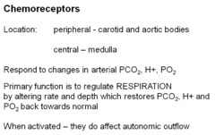
What’s normal?
http://faculty.ucc.edu/biology-atsma/misc/resp102.htm
http://humanisamiracle.imanisiteler.com/6_clip_image018.jpg

Slide 12
Compensatory Mechanics
We know those with COPD will typically have less O2 intake because of restrictive airways and retain CO2 due to ineffective gas exchange in the alveoli. Chemoreceptors adjust to this new “normal” elevated CO2 and a normal pH is achieved despite a hypoxic state.
Renal compensation involves the conservation of HCO3 after prolonged hypercarbia due to decreased alveolar ventilation. This will also help Mr. G’s pH to reach a normal level.
(Mosenifar MD, 2011)

Slide 13
To oxygenate or not to oxygenate- that is the question.
Compensatory mechanisms may take 1-3 days to achieve Mr. G’s new “normal” pH. Patients with chronic hypercapnia no longer sense the need to increase ventilations because of the decreased sensitivity of the central chemoreceptors. Peripheral chemoreceptors begin to “kick in” when the PO2 <60mm Hg. Therefore, if oxygen administration increases Mr. G’s PO2 level beyond his new “normal,” then his ventilatory drive may be depressed. Similarly, it is the withdrawal of the oxygen after the exacerbation that must be a gradual process so as to avoid sudden shifts in pH. A person who is dyspneic & hypoxic should be given enough oxygen to meet their metabolic needs.
(Inspired Technologies, Inc, 2007)
(Porth, 2009)

Slide 14
Mr. G’s “normal” pH changes stimulate chemoreceptors that will change breathing rate & depth. COPD exacerbation induces Respiratory Acidosis initially and Mr. G’s pH will be _____. He will attempt to adjust his pH by “blowing off” _____. With chronic obstructive problems, O2 cannot reach alveoli (where O2 & CO2 are exchanged), causing Mr. G to grow accustomed to CO2 retention. Renal compensatory mechanisms will attempt to normalize Mr. G’s pH in his chronic respiratory acidotic state.
Decreased; CO2
Yes! A low pH = acidosis.. Exhaling CO2 is the mechanism to raise pH!
Unchanged; steam
Lets think about this. His chemoreceptors have already been stimulated by a change in pH. CO2 is exhaled & H2O is retained.
Increased; HCO3
Nice try, but an increased pH.=Alkylosis. HCO3 is retained in the kidneys as an attempt to raise the pH.

Slide 15
Oxygenation
Why are current guidelines for oxygen therapy to maintain O2 saturations between 90-92% and not above 95%?
(Global Initiative for Chronic Obstructive Lung Disease, Inc, 2011)
Patients with COPD will never reach 95%.
This is not true. If administering 100% oxygen by a mask, it is often possible to get this patient above 95%, but it isn’t the best practice.
A normal pH associated with a low PO2 but an elevated CO2 is typical of chronic hypercapnia.
This is true. Compensation in respiratory acidosis can take place & patients become chronic CO2 retainers. However, adequate oxygenation should be a a primary concern.
Mr. G will become oxygen dependent for life if we keep his saturations at 95%.
Oxygenating him won’t cause O2 dependency, however, Mr. G has developed a new “normal.” High flow oxygen can cause a paradoxical exacerbation in the patient who has developed compensatory mechanisms.

Slide 16
An Ounce of Prevention
After recovery, the FNP encourages Mr. G to get the flu & pneumonia vaccines. Why is this an important preventative measure for Mr. G?
Lung infections cause an inflammatory response, thereby creating more mucous & air flow resistance.
Exactly right!
It is required by law
This isn’t true.
Vaccines can prevent COPD.
That would be nice but vaccines can only build the immune response to infections that will exacerbate COPD. Several bacterial lung infections can be prevented by the pneumococcal vaccines.(Hunter & King, 2001)

Slide 17
You should know…
Hypercapnia as a normal state in the patient with COPD exacerbation. (slide 12)
Common treatments of COPD. (slide 10)
Careful considerations when oxygenating a patient with COPD. (slide 13)
Strategies to prevent COPD exacerbations. (slide 16)

Slide 18
Literature Cited
(n.d.). Retrieved March 5, 2012, from All About Pharmacy and Drugs: http://www.pharmacy-and-drugs.com/illnessessimages/copd.jpg
Atsma PhD, B. The Respiratory System. (2009). Retrieved March 31, 2012. http://faculty.ucc.edu/biology-atsma/misc/resp102.htm
The Daily Sign Out. (2009, December 3). Pink puffer versus blue bloater. Retrieved February 21, 2012, from http://pathlabmed.typepad.com/surgical_pathology_and_la/2009/12/pink-puffer-versus-blue-bloater.html
Diwan, P. (2007, November 16). Retrieved March 5, 2012, from TopNews: http://www.topnews.in/files/healthy-vs-copd.jpg
genome.gov. (2012, January 4). Learning about alpha-1 antytripsin deficiency (AATD). Retrieved February 12, 2012, from National Human Genome Research Institute: http://www.genome.gov/19518992
Global Initiative for Chronic Obstructive Lung Disease, Inc. (2011). Global Initiative for Chronic Obstructive Lung Disease. Retrieved February 27, 2012, from www.goldcopd.org: http://www.goldcopd.org/guidelines-pocket-guide-to-copd-diagnosis.html
http://humanisamiracle.imanisiteler.com/6_clip_image018.jpg
Hunter, M., & King, D. (2001, August 15). COPD Management of Acute Exacerbation and Chronic Stable Disease. American Family Physician, 64(4), 603-613. Retrieved from http://www.aafp.org/afp/2001/0815/p603.html
Inspired Technologies, Inc. (2007, November). Retrieved February 18, 2012, from http://www.google.com/search?sourceid=navclient&aq=4&oq=co2+&ie=UTF-8&rlz=1T4SKPT_enUS450US450&q=co2+retention+in+copd&gs_upl=0l0l0l10268lllllllllll0&aqi=g4s1
Mosenifar MD, Z. (2011, October 10). Chronic obstructive pulmonary disease workup. Retrieved March 17, 2012, from WebMD: http://emedicine.medscape.com/article/297664-workup#aw2aab6b5b2
Porth, C. &. Matfin, G. (2009). Pathophysiology: Concepts of altered health. Philadelphia: Lippincott, Williams & Wilkins.
Quinn, A. D., & Sinert, R. (2009 November 13). emedicine. (E. M. Schraga, Ed.) Metabolic acidosis in emergency medicine. Retrieved February 24, 2012, from Medscape: http://emedicine.medscape.com/article/768268-overview#a0104

